Slide 1
Item 8.4(3) – Demonstration of integration of products from non-traditional source into WIPPS
Third Session of the Infrastructure Commission
(INFCOM-3, 15-19 April 2024)
David RICHARDSON / Chair SC-ESMP
17 April 2024

Slide 2
Doc 8.4(3) Draft Recommendation: Demonstration of integration of products from non-traditional source into WIPPS
Terminology:
non-traditional sources = entities other than national governmental organizations such as NMHSs, e.g. private entities or international/intergovernmental organization
Why do we need to consider non-traditional sources:
In hydrology and meteorology, an increasing number of non-traditional sources are providing global forecasting products
UN Early Warnings for All Initiative requires innovative solutions in the provision of forecasting products. INFCOM considers Flood as one of high priority hazards based on the needs of 30 priority countries.

Slide 3
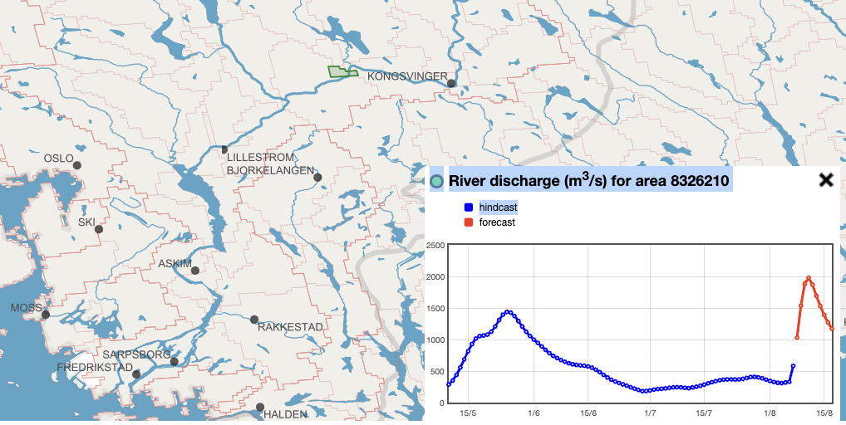
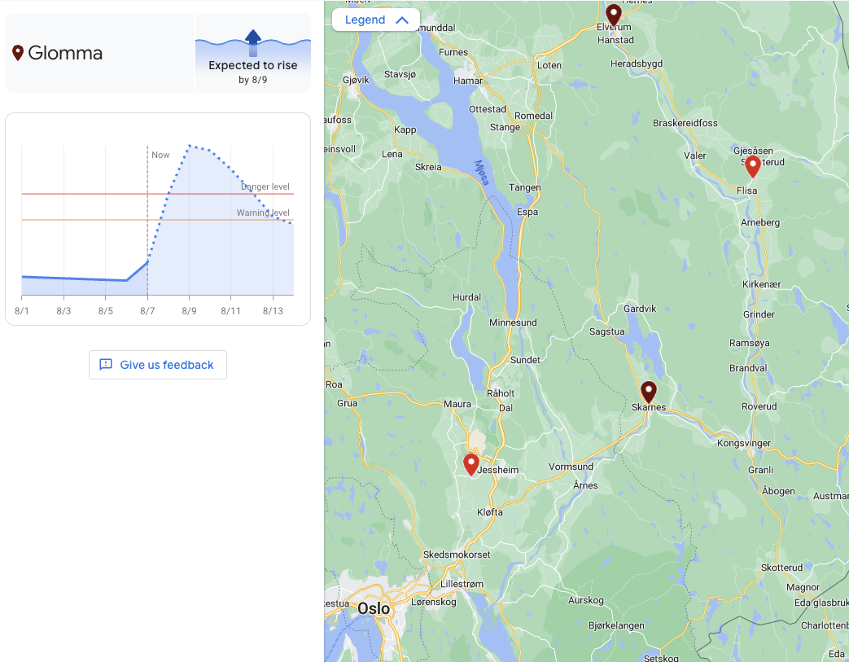
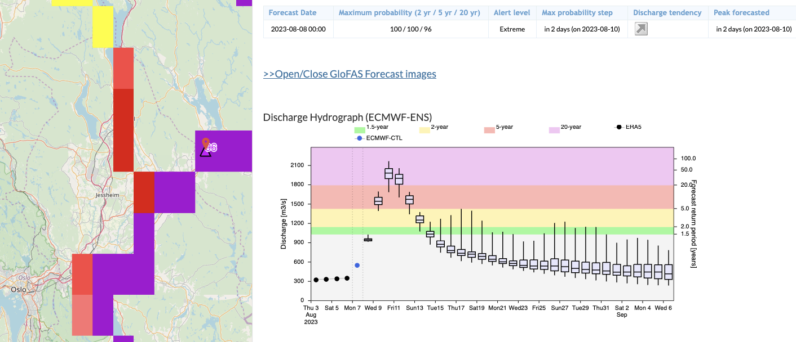
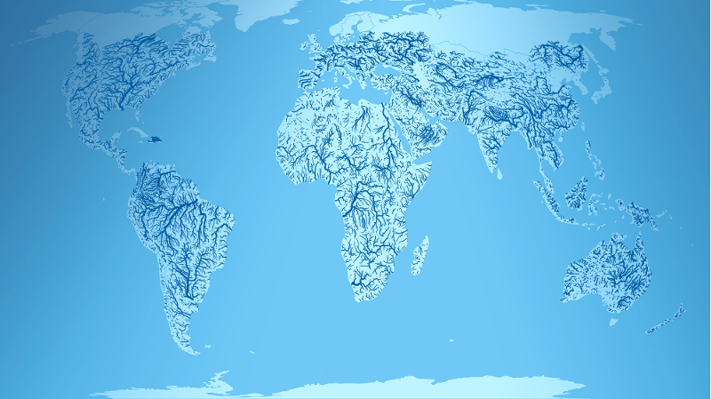
Examples of (non)-traditional sources of riverine forecasting (operational)
SMHI EU-Hype
Google Floodhub
purpose
ECWMF GLOFAS / EFAS
GEOGloWS

Slide 4
Doc 8.4(3) Draft Recommendation: Demonstration of integration of products from non-traditional source into WIPPS
Plan to demonstrate global riverine flood prediction products
INF 8.4(3) Plan for the demonstration of global riverine flood prediction products
Assess the general prospect of providing global riverine flood products from both traditional and non-traditional sources to WMO Members, supporting objectives of the United Nations Early Warnings for All Initiative (EW4All)
Gain experience with their outputs (and potential products)
Raise awareness amongst Members about the current state and potential of global flood forecast capabilities from leading providers

Slide 5
Doc 8.4(3) Draft Recommendation: Demonstration of integration of products from non-traditional source into WIPPS
Plan to demonstrate global riverine flood prediction products
INF 8.4(3) Plan for the demonstration of global riverine flood prediction products
Objectives:
Suggestions for common forecast products and formats, operational practice, verification approaches for operational global flood forecasting;
Suggestions regarding the possibility, the pathway, the product specification and the requirements to include operational global flood forecasting into WIPPS;
Collection of Members’ feedback regarding the usefulness of operational global flood prediction products.

Slide 6
Doc 8.4(3) Draft Recommendation: Demonstration of integration of products from non-traditional source into WIPPS
Plan to demonstrate global riverine flood prediction products
INF 8.4(3) Plan for the demonstration of global riverine flood prediction products
Need the guidance of the Executive Council on the non-technical aspects including the following items regardless of the type of organization
Extent to which the status of the WIPPS Designated Centre is used to promote the designated organization and its activities,
Role of the Permanent Representatives of WMO Members and the presidents of the Regional Associations in the centre designation process and procedures,
Compliance with the public-private engagement policy called on through the Geneva Declaration, to safeguard and strengthen the authoritative voice of NMHSs,
Ways to establish the commitment to, and the transparency of the products and services provided by commercial entities for the global public good

Slide 7
Doc 8.4(3) Draft Recommendation: Demonstration of integration of products from non-traditional source into WIPPS
Contribution from Members
Russian Federation, Czech, Japan, Italy
Main points
Change “demonstration of integration of products from non-traditional sources into WIPPS” to “contribution of non-traditional sources to WIPPS”
To be aligned with the single-voice principle
Propose to collaborate with SERCOM
To identify user requirements in collaboration with SERCOM
To develop a WIPPS regarding global riverine flood prediction to meet the identified requirements

Slide 8
Thank you.
^{wmo.int}

